Slide 1

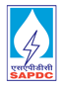


SJVN Arun-3 Power Development Company Pvt. Ltd. (SAPDC)
A presentation by Roshan Sahani

Slide 2
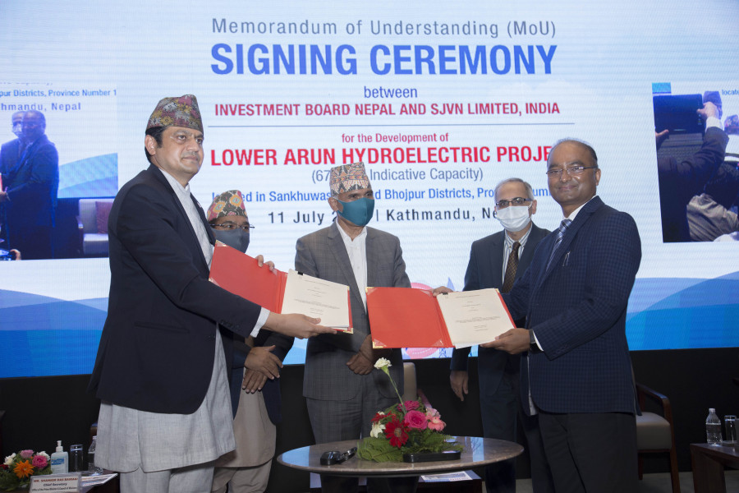
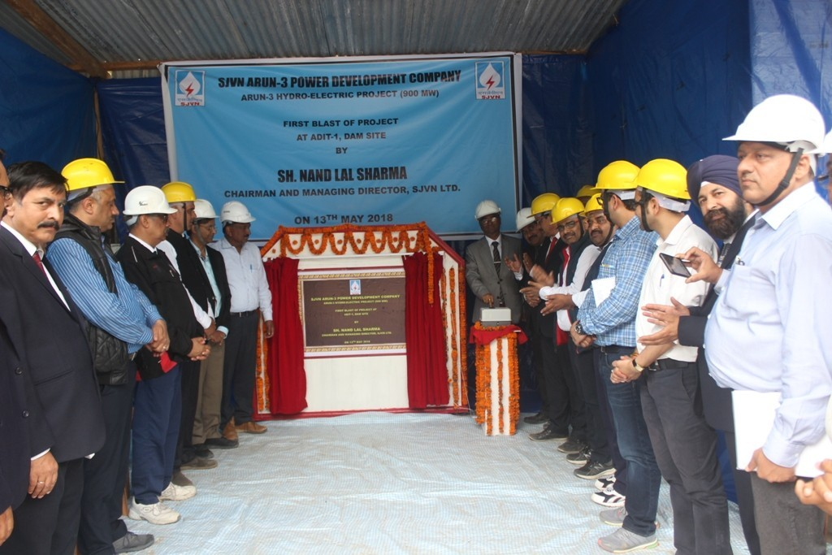
Introduction
The Arun-III hydroelectric power plant is a 900MW run-of-the-river hydropower project under construction in Nepal. Scheduled for commissioning by 2024, it will be the most extensive hydroelectric facility in the South Asian country.
After 25 Years, Nepal Government will be the sole owner.
During this 25 Years, Nepal will receive 21.9% of electricity.
SJVN's current installed capacity stands at 2,016 MW, and it aims to be a 25,000 MW entity by 2040.

Slide 3
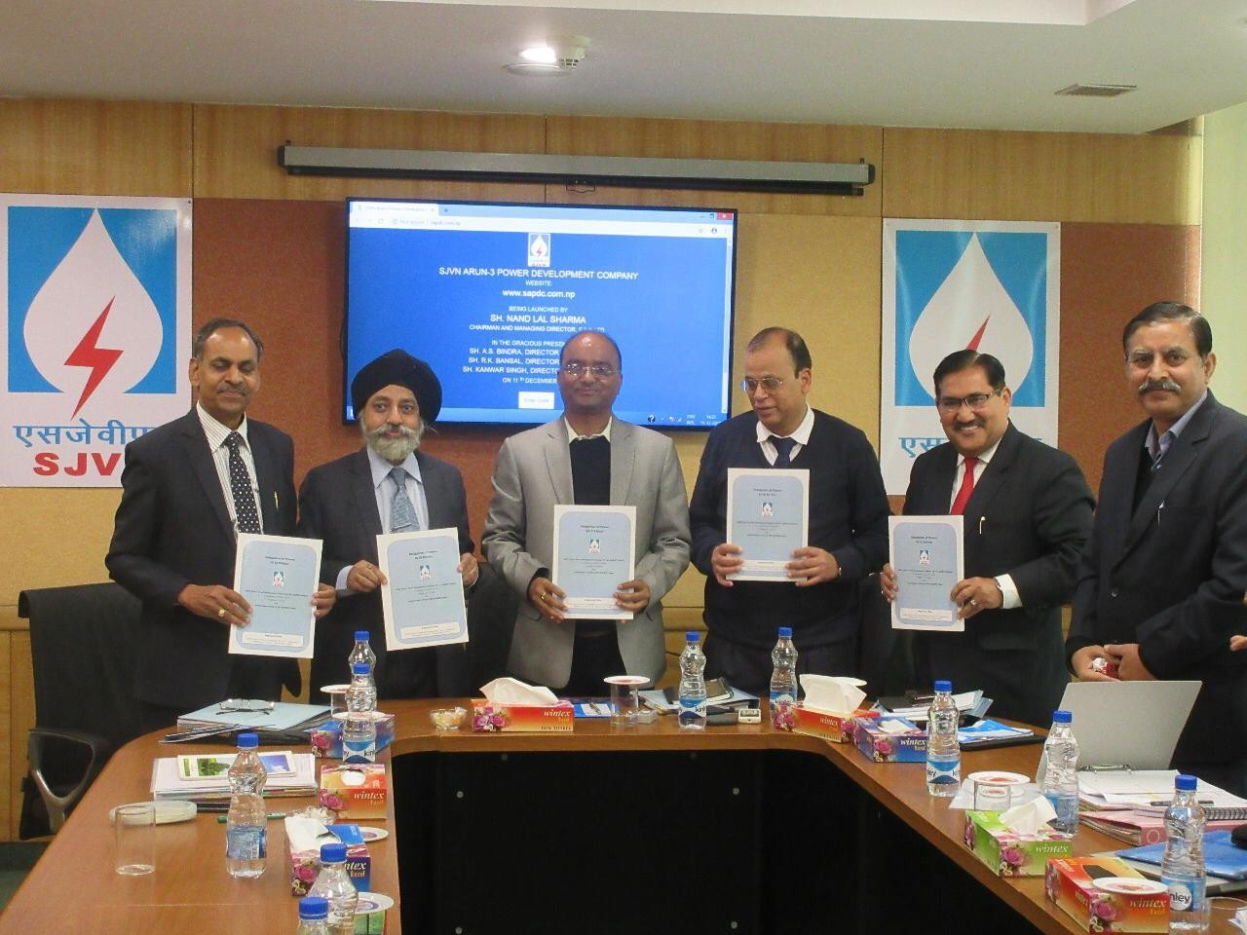
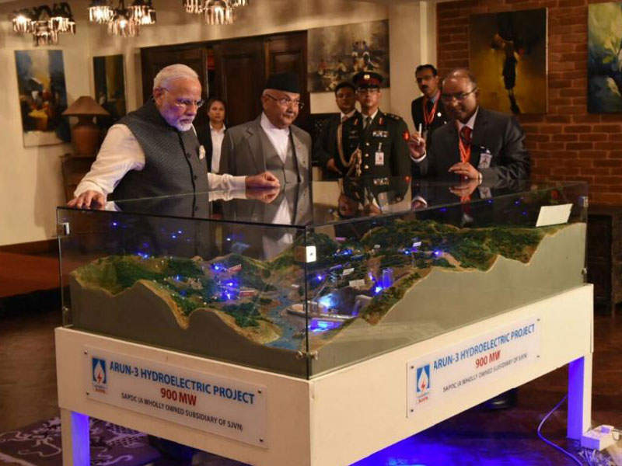
History
SJVN Arun-3 Power Development Company Pvt. Ltd. (SAPDC) was incorporated & registered on 25.04.13 as a single shareholder Pvt. Ltd. Company under the Nepalese Companies Act 2063 with SJVN Ltd. as its sole shareholder.
The principal objective of SAPDC is to Plan, Promote, Organize and Execute the 900 MW Arun-3 Hydro-electric Project. The Project Development Agreement (PDA) was signed on 25.11.14 between the Investment Board of Nepal (IBN), GoN, and SAPDC.
The project will help develop infrastructures such as the construction of roads and bridges and provide financial support for healthcare facilities and community centers, etc., which will provide a robust community infrastructure. Further, skills training and other programs will provide significant financial support to the affected communities. Total lifetime economic benefits of GoN shall be of the order of 33,866 Cr. NPR

Slide 4
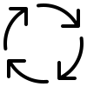
Procedure of Operation
The contract for the main project work was awarded to Patel Engineering, while the hydro-mechanical works contract was awarded to Om Metals.
The electro-mechanical equipment work, including design, engineering, manufacturing, and supply of the Francis turbines and commissioning of the project, will be carried out by BHEL as part of a contract worth Rs536bn ($83.7m).

Slide 5

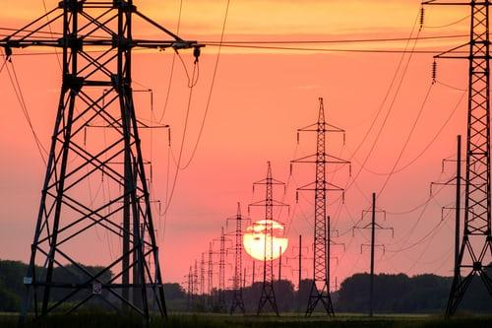
Basis of Operation
SJVN Arun-III Power Development Company (SAPDC), a wholly-owned subsidiary of India's Satluj Jal Vidyut Nigam (SJVN), is developing the project on a build-own-operate-transfer (BOOT) basis.
SVJN is a joint venture between the Government of India and the Government of Himachal Pradesh.
The estimated cost of erecting 501 towers for the power line connected to the Dhalkebar-Muzaffarpur transmission line is Rs 19.77 billion.

Slide 6
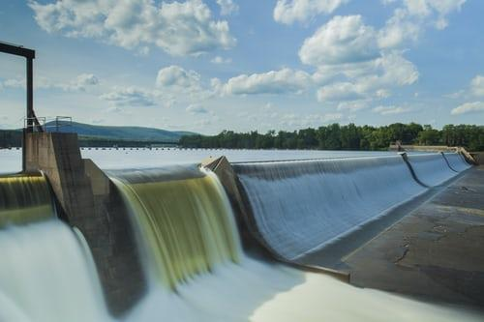
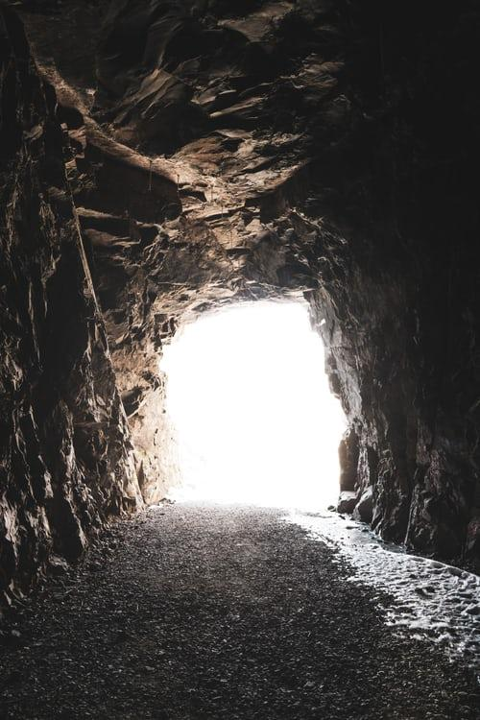


SALIENT FEATURES
Location
Hydrology
Diversion Tunnel
01
02
03
Downstream Coffer Dam
Power Intake
Upstream Coffer Dam
04
05
06
Arun River in Sankhuwasabha district, Nepal
Approx. 657km east of Kathmandu
Catchment Area at Diversion Site::26747 sq.km
Design Flood
PMF-8880 cumec
GLOF-6830 cumec
It is 429 m long, 11 m diameter to divert 1300 cumec
The height and length of the concrete barrier are 27m and 108m.
The elevation of the top level is 818m.
The height and length of the Rock Fill Dam are 5.25m and 70.64m.
The elevation of the top level is 794.25 m.
2 Intakes having 7 m diameter with horse-shoe shaped
Length::231 m each
C.L. of Intake Tunnel::
El 822 m

Slide 7


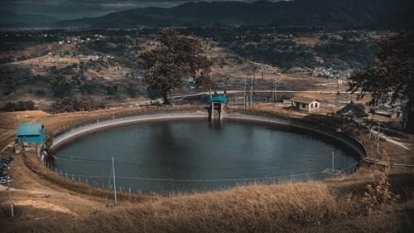
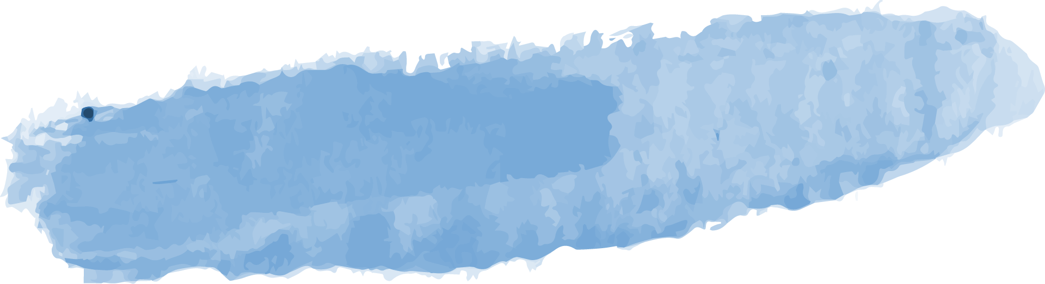

Reservoir
Submergence area at FRL
Reservoir Capacity/ Gross storage at FRL
Full Reservoir Level (FRL)
Max. Water Level (MWL)
Inactive Storage (below MDDL)
Active storage /Peaking volume
MDDL
66.3 Ha
13.94 MCM
El 847.73 m
El 845 m
8.29 MCM
5.65 MCM
El 835 m

Slide 8

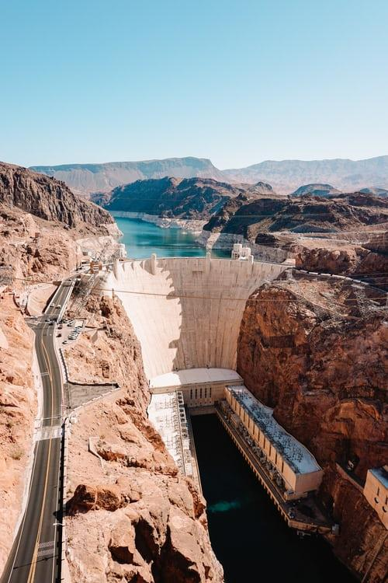


DAM
Type of Dam
Dam top Level
Concrete Gravity Dam
El.849 m
River bed Level
Dam Height above River bed
El. 790 m
59 m
Deepest Foundation Level
859
1000
Height above deepest Foundation Level
El.769 m
80 m
541
Length of Dam at Top
Top Width of Dam
233 m
7 m

Slide 9


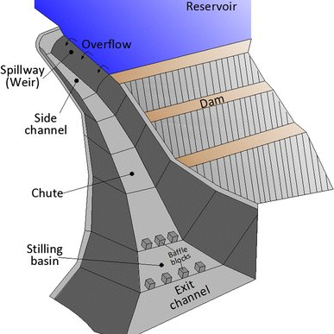
Spillway
 | Design Flood | Sluice spillway | Overflow spillway
 | PMF-8880 cumec GLOF -6830 cumec | No:5 Size: 9.0 m (W)X 14.85 m (H) | No: 1 Size: 4.0 m (W)X 3.0 m (H)
Energy Dissipation System
Trajectory Bucket type
Crest Level
El 795 m-Sluice Spillway
El 842 m-Overflow Spillway

Slide 10
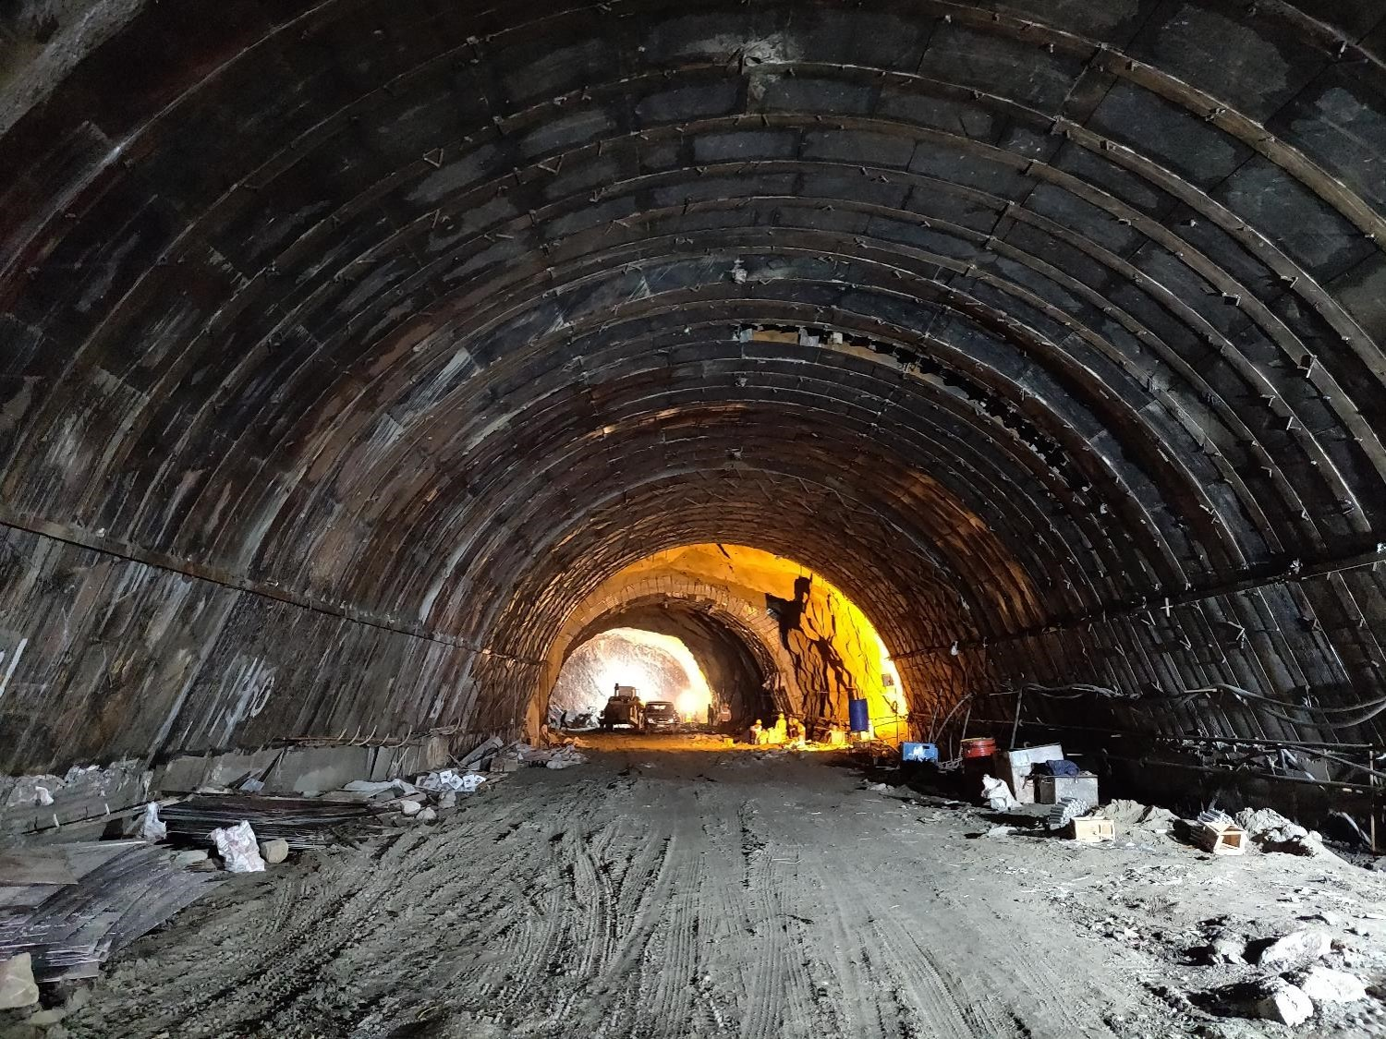
Intake Tunnels
No. & Type:2 Intakes, 7 m diameter, horse-shoe shaped
C.L. of Intake Tunnel:El 822 m
Length: 231 m each

Slide 11
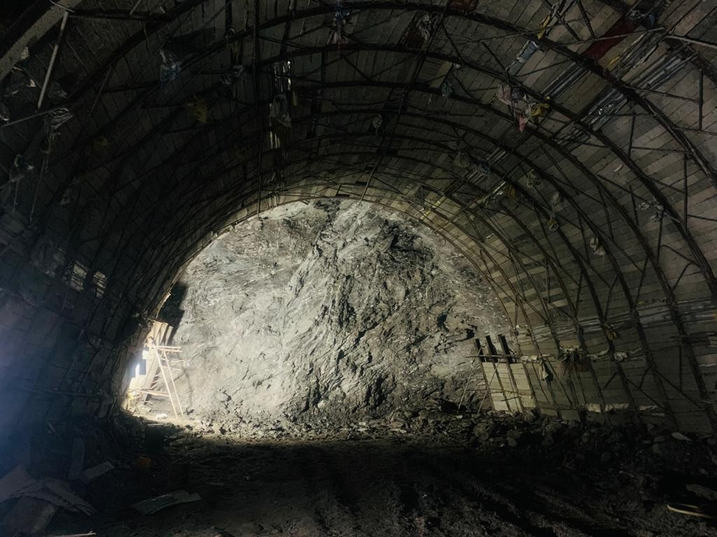
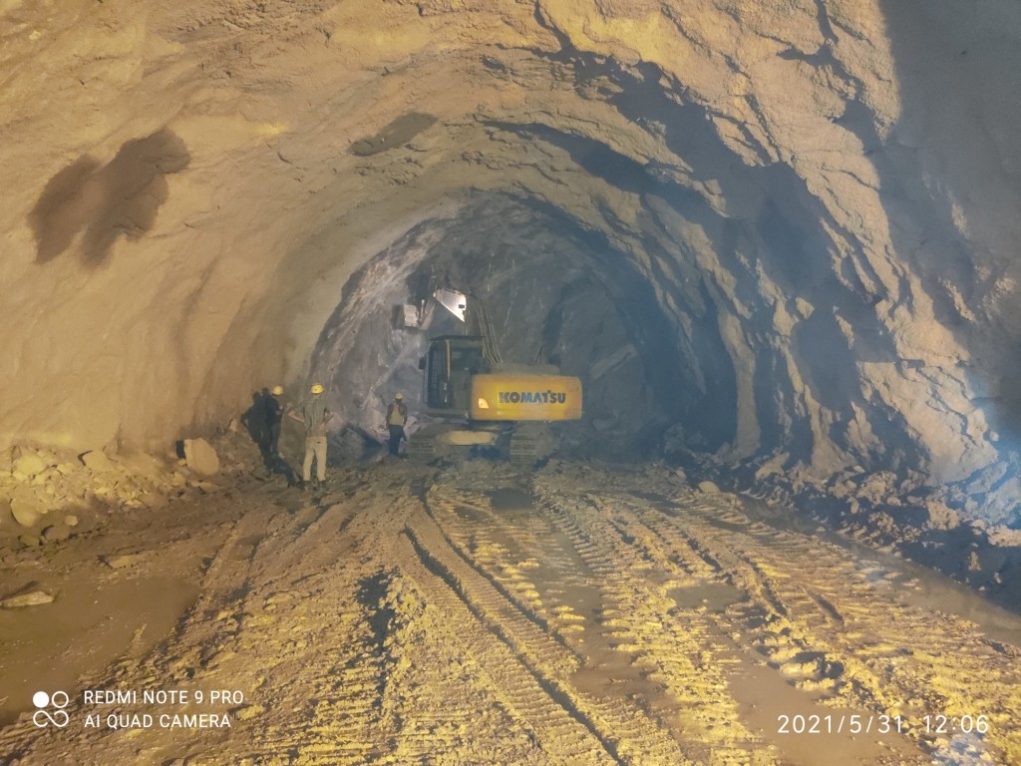
Shape & Size
Length of Tunnel
Head Race Tunnel
Design Discharge
No. of Adits& size
Horse-shoe, 9.5 m diameter
11837 m
344.68 cum / sec
4 Adits
7 m X 7 m D - shaped

Slide 12
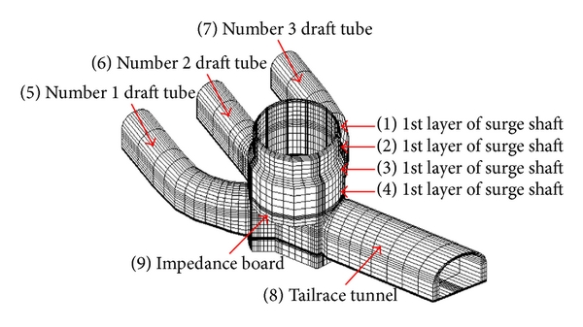



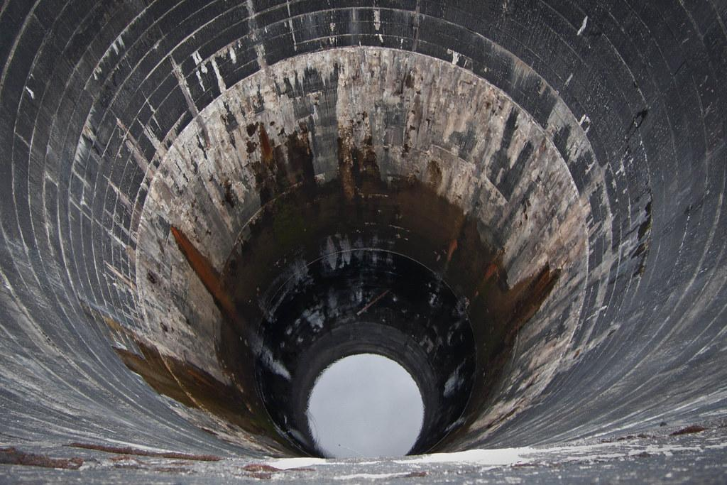
Surge Shaft
Size & shape
Height
Top Level
Gates,No.& Size
Open to sky,Restricted Orifice
1No.,24.0m diameter, Circular
155m
El 946.00 m
2 Gates.
5.5m ( W )X 5.5m (H )Each

Slide 13


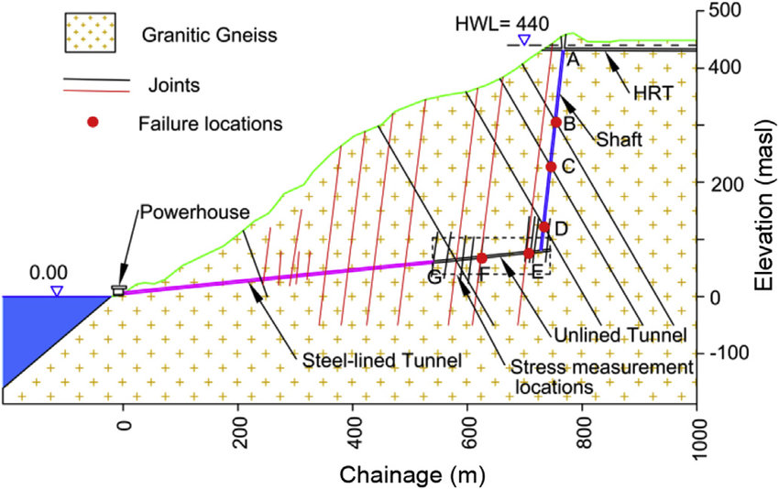
Pressure Shaft
Pressure shaft-I
Branch 1
Lenght
Of Pressure
Shaft
Branch 2
Branch 3
Pressure shaft-2
Branch 4
2 Pressure Shaft which are underground
They are Circular in Shape each of 5.5 m diameter bifurcating into two nos of 4.0 m diameter to feed four units
432 m
70 m
58 m
70 m
404 m
58 m

Slide 14
Power House Complex
Type:Underground on left bank
P/H Cavern: 179.50 m(L)X22.5 m (W)X49.5 m (H)
Design Head ( net ): 286.21 m
Gross Head: 307.67 m
Turbine: 4, Vertical Francis turbine, 225 MW each
Rated speed of Turbine: 250 rpm
Generation voltage: 15.75 kV
Service Bay Floor Level: El. 539.00m
Generator Floor Level: El. 534.00 m
Turbine Floor Level: El. 529.00 m
Distribution Centre Line Level: El. 525.00 m
MIV Floor Level: El.520.50 m
Maximum Tail Water Level: El. 536.46 m
Transformer: Single phase, 12+1 (Spare), 92 MVA 15.75 kV/420/Root 3kV

Slide 15
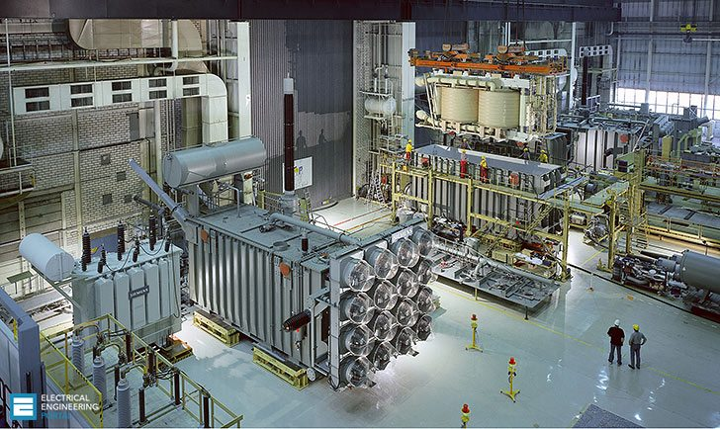
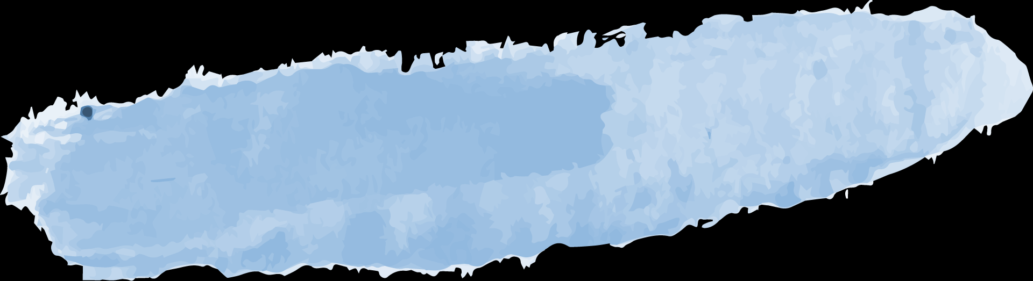
Transformer Hall
Size
Transformer Hall Floor Level
Design Discharge per unit
146.14 m (L)X 16 m (W)x 23 m ( H )
El. 552 m
86.17 Cumec
Design Energy in a 90 % dependable year
Annual Load Factor
Weighted average efficiency of TG Set
3924.03 MU
50.98 %
93 %

Slide 16
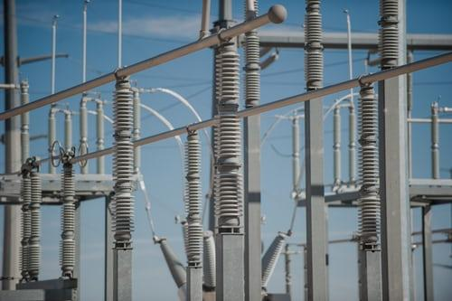
Switchyard
Elevation: El 557 m
Size: 160 m (L)X 80 m (W)

Slide 17
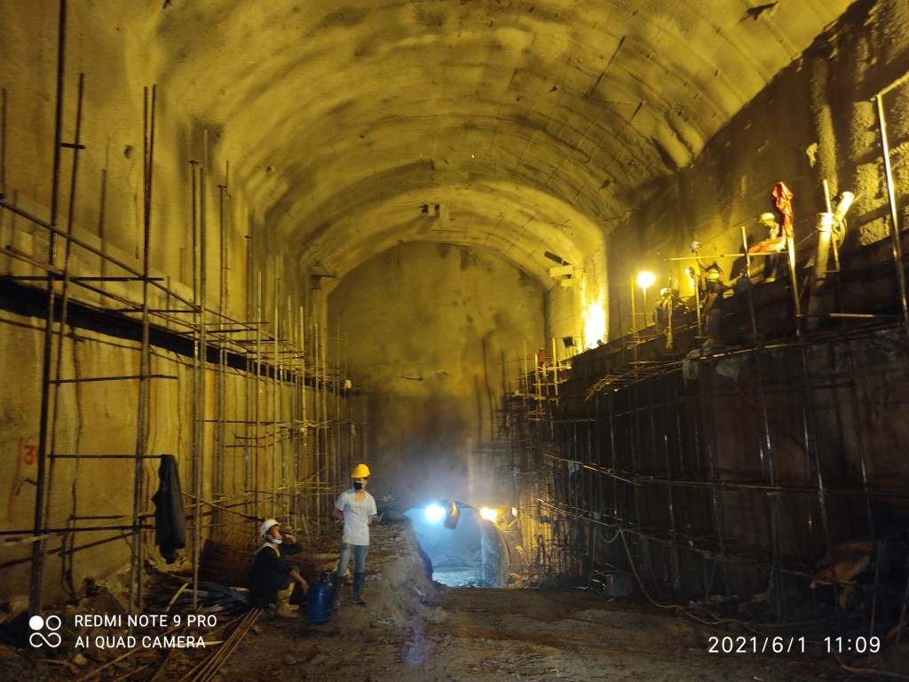
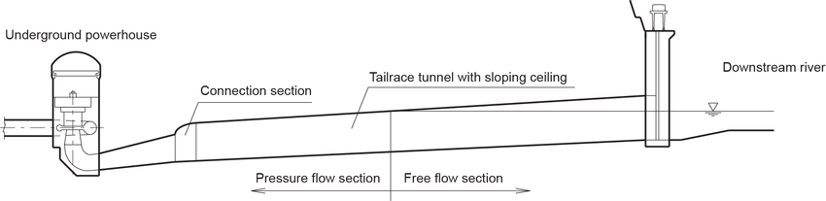
MORE FEATURES
Tail Race Tunnel
Butterfly Valve Chamber- Underground
One Tail Race Tunel
Horse-shoe Shaped
10.00 m Diameter
151.97 m Long
Size: 83.05m (L) X 12 m(W) X 21 m(H)
Butterfly Valve: Two valves with 5.5 m diameter each

Slide 18

Progress Report
Upto 31st May 2021

Slide 19



Major Civil Works
Package-C1
Package-C2
Machinery
Workforce
Human resources
8 ROC's, 4 shot Crete machine, 2 Batching plants, 1 Crusher plant of 50 TPH & 2 of 10 TPH, 9 DG Sets, four concrete pumps, nine grout pump, eight compressors, 18 excavators, 3 JCB Excavator, 52 dumpers, seven dozers, three wheel loaders, six cranes, etc.
1243 workforces are used.
Machinery
5 ROC's, two raise climbers, 1 Gantry Crane 15T, six concrete pumps, 8 shot Crete machine, 5532 kVA DG sets, 14 compressors, 15 excavators ,5 JCB excavator, five batching plants, seven grout pumps, three loaders, four-wheel loader, 39 dumpers, etc.
1266 human resources are used.

Slide 20





HYDRO-MECHANICAL WORKS
Materials Quality Assurance Procedure
Design
Drawings
Manufacturers
Fabrication
Main Intake
Completed
Completed
Completed
Completed
Completed
In Progress

Slide 21
ELECTRO-MECHANICAL WORKS
Spiral inlet pipe unit-1
DT cone and DT liner of Unit-1 & 2
Site enabling store
Design and Drawings
In Progress
Received at site
Under Inspection
Developed

Slide 22
Some Other Completed Works:
98.9%
95.9%
77%
47.2%
Construction of approach road work for the bridge foundation at the left bank is completed.
C/o VIP Guest House: Completed at Power House.
Minor dressing Works are being done with limited human resources.
Cabinet approval has been accorded on 19/5/2021
Erection of Poles
Erection of Hardware
Conductor Stringing
Head Race Tunnel (HRT)
958 completed out of a total of 998
240 Km completed out of total 301 Km
5589m out of 11837m.
988 completed out of a total of 998

Slide 23
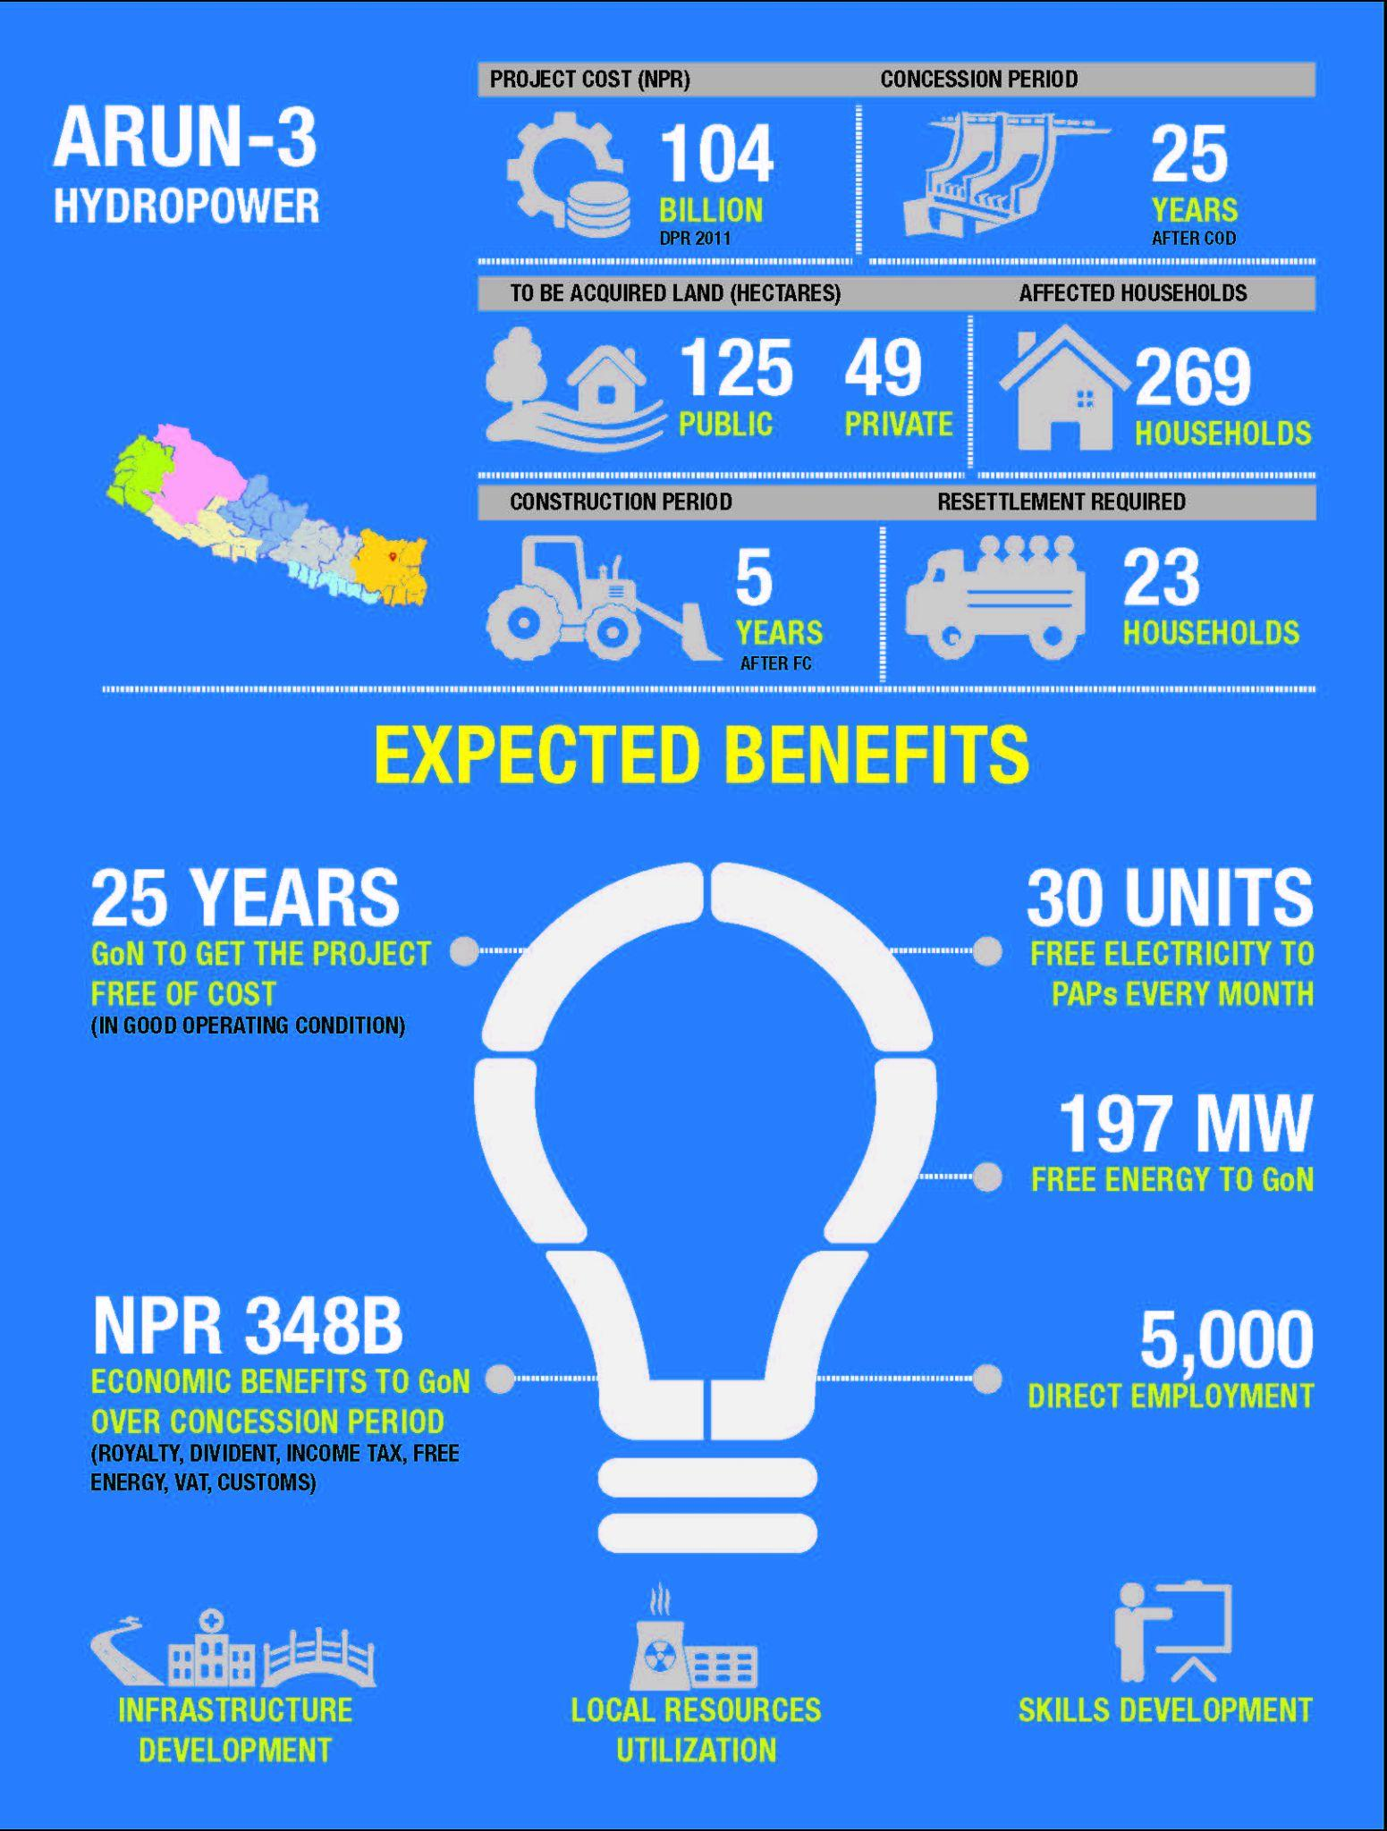
Overall DATA

Slide 24
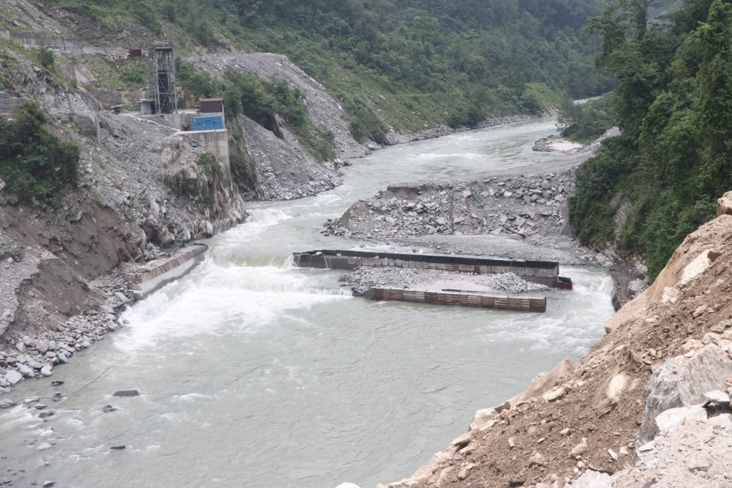
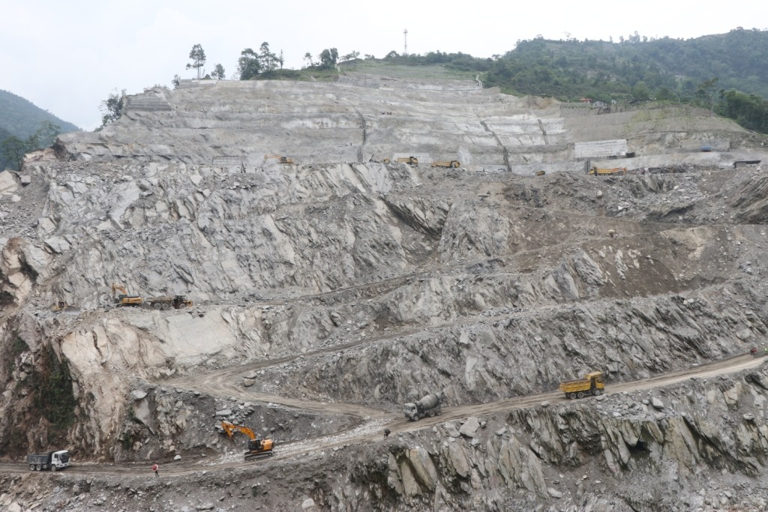
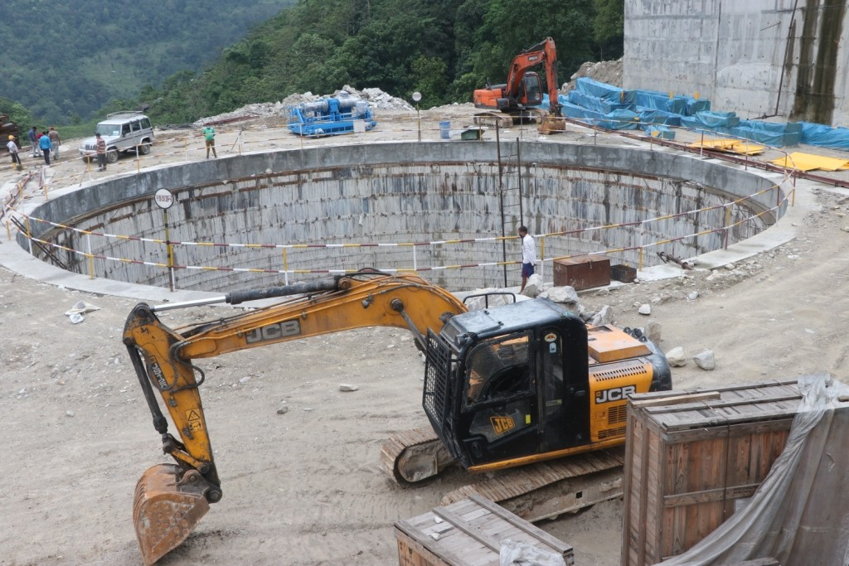
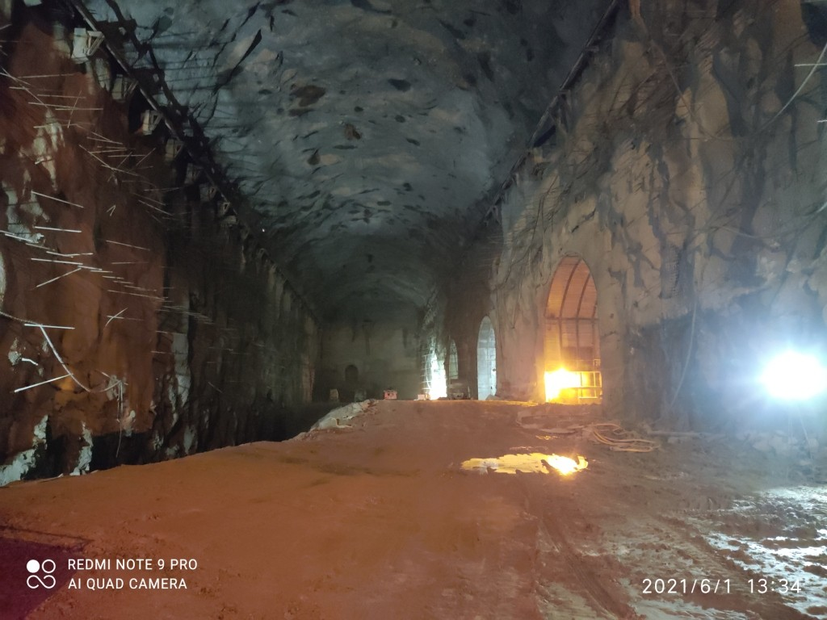
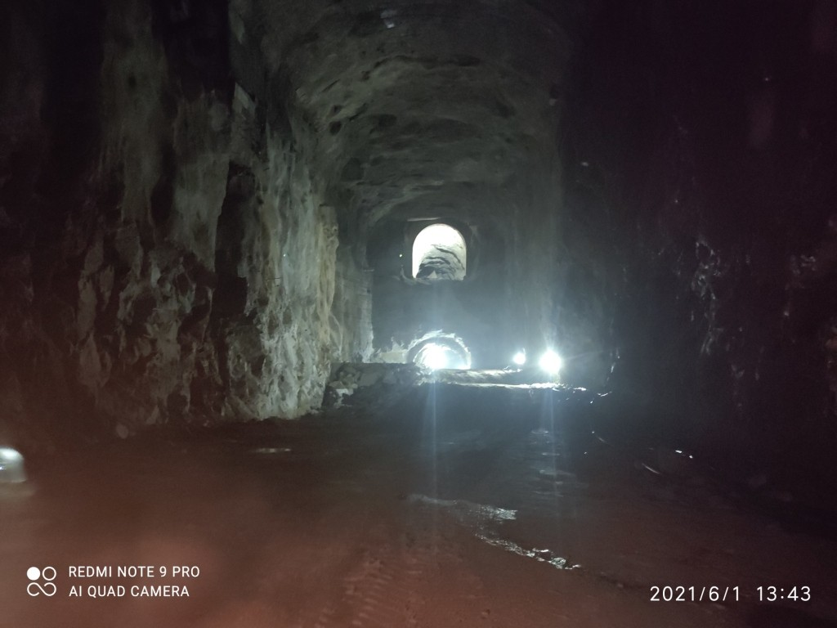
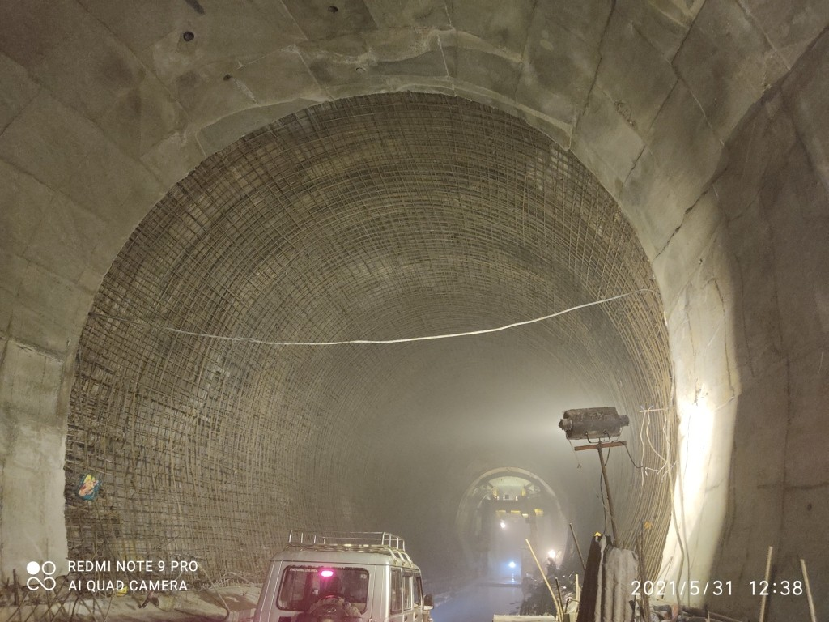
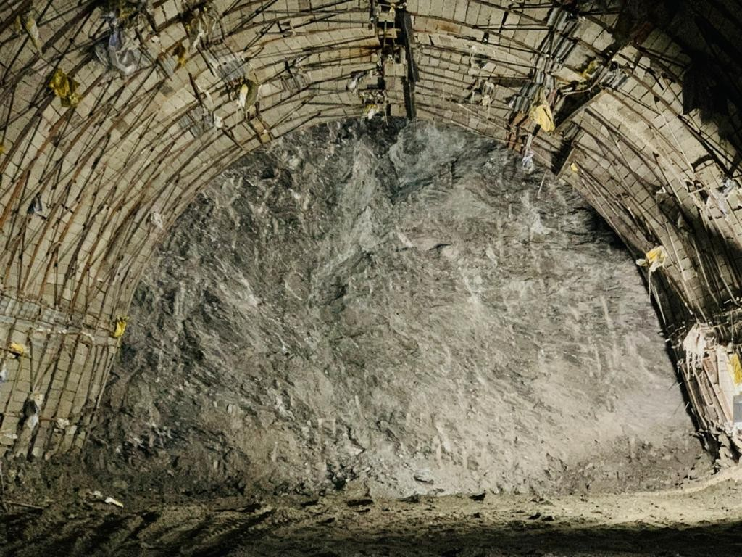
SOME IMAGES TAKEN AT CONSTRUCTION SITES:
Coffer Dam
Exc. for Dam Right Bank
Surge Shaft Exc.
Power House Exc.
Transformer Hall Exc.
Butterfly Valve Chamber Exc.
HRT Face-1
HRT Face-2
HRT Face-3
HRT Face-4

Slide 25
REFERENCES
https://www.sapdc.com.np/
https://www.power-technology.com/
https://www.aboutcivil.org/
https://en.wikipedia.org/
https://www.quora.com/
https://www.kathmandupost.com

Slide 26

THANKS
Do you have any questions?

